Slide 1

Employee Management System

Slide 2
About me
Name : Sakshi Pravin Patil
Background : B.E (Automation and Robotics)
I come from an Automation and Robotics background and have seen how industries are becoming more data-driven. During my final-year project on a strawberry harvesting robot using OpenCV, I worked on collecting data and training a model to classify ripe and rotten strawberries. At that time, I had limited knowledge of data science, which made me realize its importance. This motivated me to learn data science to strengthen my analytical skills, support better decision-making, and expand my career opportunities in a competitive industry.
Fresher
linkedin - https://www.linkedin.com/in/sakshi-patil-482245251
Github – https://github.com/sakshipatil06112003

Slide 3
Maintain data integrity and consistency through primary keys, foreign keys, and constraints
Objective of the Project
To design and implement a relational Employee Management System using SQL to handle real-world organizational data.
To efficiently manage employee details, job roles, departments, payroll, qualifications, and leave records in a centralized database.
To ensure data integrity and consistency by using appropriate primary keys, foreign keys, and constraints.
To perform SQL-based data analysis for generating meaningful HR and payroll insights.
To support data-driven decision-making for effective employee and organizational management.

Slide 4
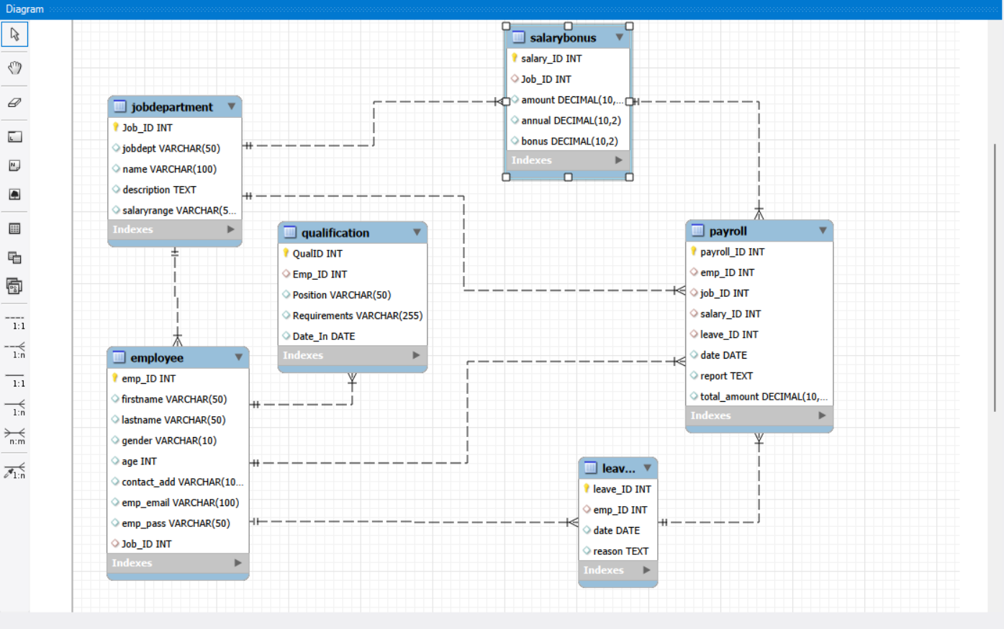
EER Diagram

Slide 5
SQL Query Results
1. How many unique employees are currently in the system?
Query :
Select Count(Distinct emp_ID) as unique_employees
from Employee;
Output :
Unique_employees
60
2. What is the total monthly payroll processed?
Output :
Query :
Select SUM(Total_Amount) as Total_Monthly_Payroll
From payroll;
Total_Monthly_Payroll
2778000.00

Slide 6
3. What is the average salary per department?
Query :
Select jd.jobdept as department,
avg(sb.amount) as avg_monthly_salary
from Employee e
join JobDepartment jd on e.Job_ID = jd.Job_ID
join SalaryBonus sb on jd.Job_ID = sb.Job_ID
Group by jd.jobdept
Order by avg_monthly_salary Desc;
Output :
department | Avg_monthly_salary
Legal | 84600.000000
Engineering | 81142.857143
Sales | 75428.571429
Finance | 72333.333333
IT | 70888.888889
Operations | 68750.000000
Marketing | 65625.000000
HR | 62571.428571

Slide 7
4. Which departments have the highest total salary allocation?
Query :
Select jd.jobdept as department,
Sum(p.total_amount) as total_salary_allocation
From Payroll p
Join Employee e On p.emp_ID = e.emp_ID
Join JobDepartment jd On e.Job_ID = jd.Job_ID
Group by jd.jobdept
Order by total_salary_allocation Desc
Limit 1;
Output :
department | total_salary_allocation
Finance | 420500.00

Slide 8
5. What is the average number of leave days taken by its employees per department?
Query :
Select Jobdept,
AVG(LeaveCount) AS Avg_Leave_Days_Per_Employee
From (
Select e.emp_ID, jd.Jobdept,
COUNT(l.leave_ID) AS LeaveCount
FROM Employee e
JOIN JobDepartment jd ON e.Job_ID = jd.Job_ID
LEFT JOIN Leaves l ON e.emp_ID = l.emp_ID
GROUP BY e.emp_ID, jd.Jobdept
) AS temp
GROUP BY Jobdept
ORDER BY Avg_Leave_Days_Per_Employee DESC;
Output :
department | Avg_Leave_Days_Per_Employee
Operations | 1.0000
Finance | 1.0000
IT | 1.0000
Marketing | 1.0000
Engineering | 1.0000
Sales | 1.0000
HR | 1.0000
Legal | 1.0000

Slide 9
6. What is the average value of total_amount after considering leave deductions?
Query :
Select AVG(Total_Amount - (Leave_Count * 500))
as Average_After_Deductions
From (
Select p.emp_Id,
p.Total_Amount,
COUNT(l.leave_Id) AS Leave_Count
From Payroll p
Left join Leaves l on p.emp_Id = l.emp_Id
Group by p.emp_Id, p.Total_Amount
) as t;
Output :
Average_After_Deduction
45800.000000

Slide 10
Business insights
Business Insights :
Certain departments have a higher employee count, leading to uneven workload distribution across the organization.
Departments with more employees also show higher total payroll expenditure, indicating a direct link between workforce size and salary cost.
Average salary differs by department, mainly due to different job roles and salary structures.
A small group of employees contributes to the highest payroll amounts, usually due to higher roles or bonuses.
Employee leave records directly impact payroll, as leave deductions reduce the final payable salary.

Slide 11
Recommendations
Recommendations:
Balance employee distribution across departments to reduce workload pressure and improve productivity.
monitor payroll-heavy departments to control overall salary and bonus expenses.
Review compensation structures for roles that have a high impact on payroll to ensure cost efficiency.
Analyze employee leave patterns and introduce leave policies to minimize frequent payroll deductions.
Use qualification data to plan employee training, promotions, and better role assignments.

Slide 12
Conclusion
Designed and implemented a relational Employee Management System using SQL.
Created interrelated tables to manage employee, job, department, salary, leave, qualification, and payroll data.
Established proper relationships using primary keys and foreign keys to maintain data integrity.
Executed SQL queries with joins and aggregations to analyze employee distribution, salaries, leaves, and payroll.
Identified departments with higher employee count and higher salary expenditure.
Analyzed the impact of employee leaves on payroll calculations through salary deductions.
Used qualification data to understand skill distribution and role assignments across departments.

Slide 13
Challenges
Designing correct relationships between multiple interrelated tables in the database.
Implementing foreign keys with appropriate cascading actions to maintain referential integrity.
Writing SQL queries involving multiple joins across employee, job, salary, leave, and payroll tables.
Handling NULL values while analyzing payroll and employee leave data.
Calculating accurate totals and averages using aggregate functions such as SUM() and AVG().
Ensuring data consistency while linking employee, salary, and leave information across tables.

Slide 14

THANK YOU

